Slide 1
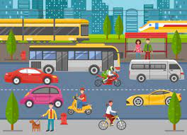
Public transportation efficiency analysis
Presented by
JANANI R

Slide 2
Contents :
Introduction
Importance Utilisation
Data Collection and Analysis
Data Collection Diagram
Green Transportation For Sustainability
Means Of Transsport
Advantages & Dis advantages

Slide 3
Introduction :
Welcome and Introduction Purpose of the Presentation: Analyze the current state of public transportation efficiency Identify key performance indicators (KPIs) Propose strategies for improvement

Slide 4
Important Utilisation :
Efficiency Defined: Capacity utilization Timeliness Cost-effectiveness Significance for Urban Sustainability and Economic Growth

Slide 5
Data Collection and analysis :
Sources of Data: Ticketing Systems GPS and Tracking Software Passenger Surveys Maintenance Logs Data Analytics Tools and Techniques

Slide 6
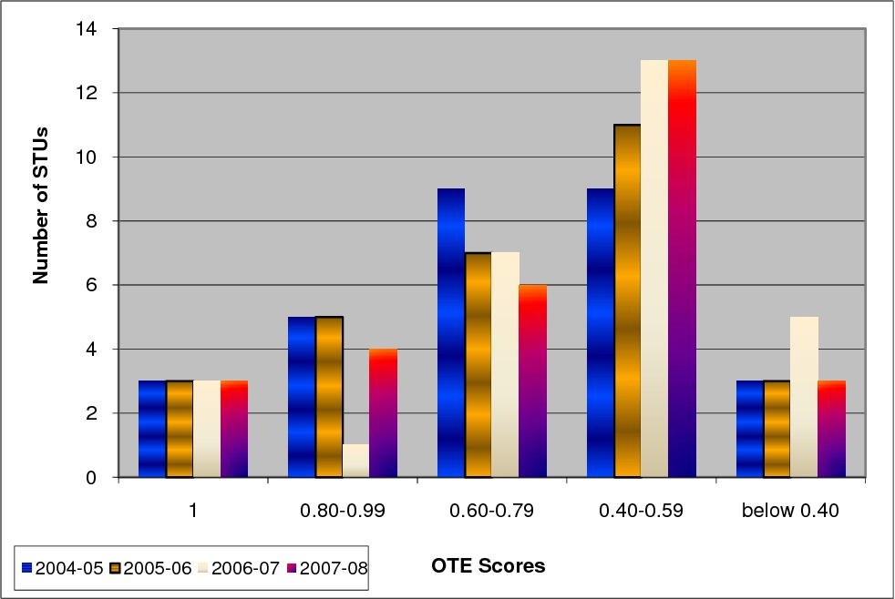
Data Collection & analysis Diagram

Slide 7
Green Transportation For sustainability :
Importants
Types :
Reducing Carbon Emissions Mitigating Air Pollution Alleviating Traffic Congestion Enhancing Urban Livability
Electric Vehicles (Evs) Hybrid Vehicles Public Transit and Mass Rapid Transit (MRT) Cycling and Walking Carpooling and Ride-sharing

Slide 8
Means Of transportation
Explore various modes of transportation Discuss their characteristics, advantages, and limitations Highlight their importance in modern society
Examples:(Walking, Bicycle, Bike, Car, Bus, Tarin, Metro, Taxi Ride, Airplanes, Ships.

Slide 9
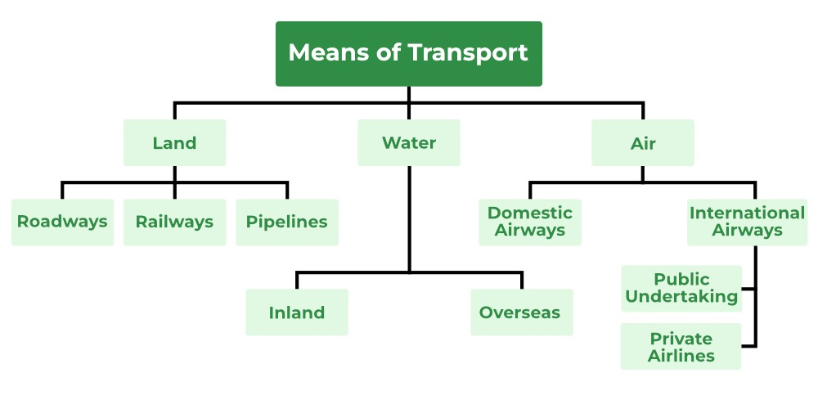
Means Of Transport

Slide 10
Public transportation efficiency analysis
Advantages:
Dis Advantages:
Reduces Traffic Congestion Increased Accessibility Promotes Social Equity Improves Public Health Enhances Quality of Life
Safety Concerns Privacy Concerns Weather Dependency Resistance to Change Initial Setup and Investment Costs

